Slide 1
Netflix Content Strategies
Unveiling Trends in Netflix Viewership: Content Preferences, Peak Periods, and Growth Insights

Slide 2
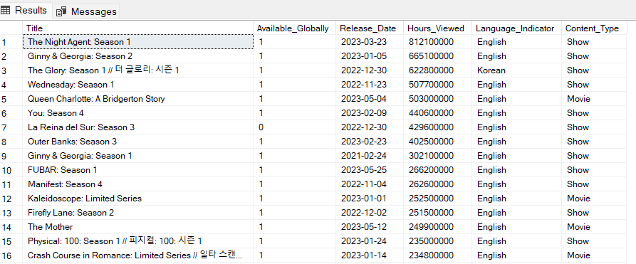
Text cleaning: in the title for some records the name is given in English
and non-English language. So , lets remove the Non-English part.
select * from dbo.netflix_content_2023;

Slide 3
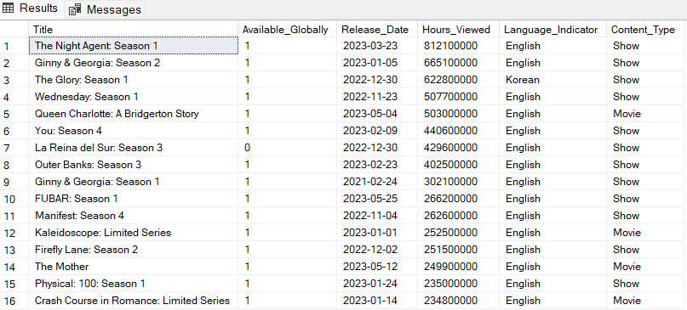
Update dbo.netflix_content_2023
set Title = case
when Title like '%//%'
Then left(Title, Charindex('//', Title)-1)
Else Title
End;

Slide 4
Data Analysis
What are top 3 shows/movies with highest watch time
Which content type have most watch time
Which year has the highest watch time
Which month has the highest watch time
which weekday release has the highest watch time
What is the trend of viewership of Netflix for this period (2011 – 2023)

Slide 5

1) What are top 3 shows/movies with highest watch time
select top 3 Title, Hours_Viewed from dbo.netflix_content_2023
order by Hours_Viewed desc;

Slide 6

2) Which content type have most watch time
select top 1 Content_Type, sum(cast(Hours_Viewed as bigint))
as watchtime from dbo.netflix_content_2023
group by Content_Type
order by sum(cast(Hours_Viewed as bigint)) desc;
Shows are more popular than the Movies

Slide 7

3) Which year has the most viewership
About 60% of the released date column is Null values.
Ignoring those null values 2023 is the year with highest viewership.
select year_, watchtime into #temptable from (
select year(Release_Date) as year_, sum(cast(Hours_Viewed as bigint)) as watchtime
from dbo.netflix_content_2023
where Release_Date is not null
group by year(Release_Date)) as a;

Slide 8

4) Month with the highest viewership
select top 3 month(Release_Date) as month_,
sum(cast(Hours_Viewed as bigint)) as watchtime
from dbo.netflix_content_2023
where Release_Date is not null
group by month(Release_Date)
order by watchtime desc
It is clearly evident that Netflix will get higher viewership
at the end of the Year.

Slide 9
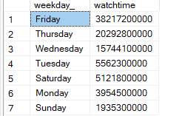
5) Weekday with highest viewership – Friday is the weekday with highest viewership
select Datename(weekday, Release_Date) as weekday_,
sum(cast(Hours_Viewed as bigint)) as watchtime from dbo.netflix_content_2023
where Release_Date is not null
group by Datename(weekday, Release_Date)
order by watchtime desc

Slide 10
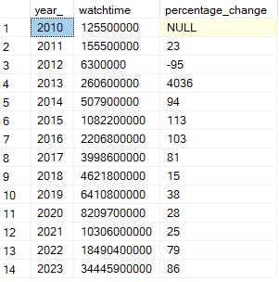
6)What is the trend of viewership of Netflix for this period (2011 – 2023)
select year_, watchtime,
((watchtime-lag(watchtime,1) over (order by year_))*100)/
(lag(watchtime,1) over (order by year_)) as percentage_change
from #temptable

Slide 11
Key Takeaways
Higher Engagement for Series: Series outperformed movies in terms of viewership,
indicating a preference for episodic content.
Peak Viewership in 2023: The year 2023 recorded the highest number of views,
reflecting Netflix's growth trajectory.
Seasonal and Temporal Trends: December emerged as the top-performing month,
with Fridays leading in weekly viewership.
Strategic Content Releases: Netflix strategically schedules content releases
at year-end, weekends, and holidays to maximize engagement.
Consistent Growth: Netflix viewership witnessed an impressive 30% CAGR growth
between 2010 and 2023, showcasing its expanding audience base.

